Slide 1
Final Year Project: Week 6 of 20
Marij Qureshi 16th Jan 2020
Robust Optimisation of Composite Panels

Slide 2
Progress this week
New mono-string model
Composite lay-up on abaqus
Deterministic geometry optimisation … ALMOST

Slide 3
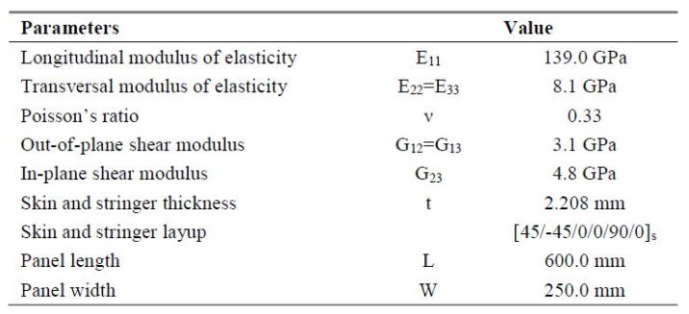
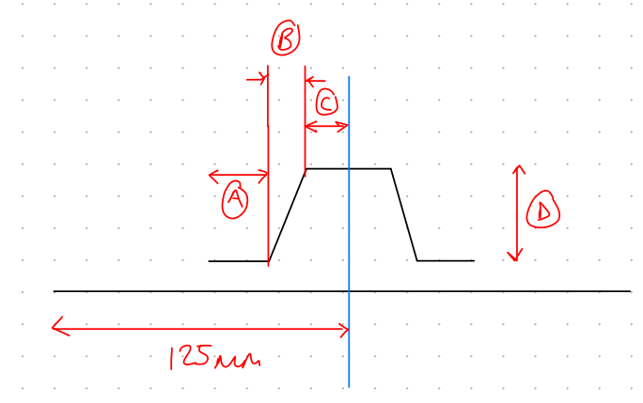
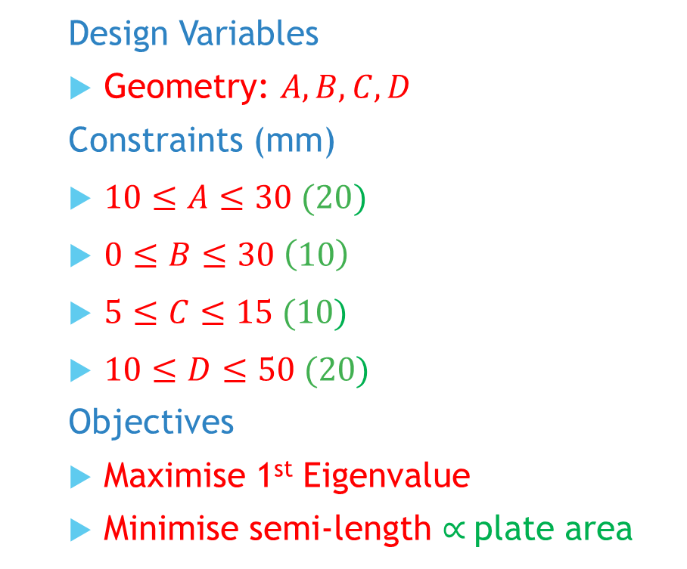
Mon-string Model
Design Variables
Geometry: $A,B,C,D$
Constraints (mm)
$10≤A≤30 (20)$
$0≤B≤30 \left(10\right)$
$5≤C≤15 (10)$
$10≤D≤50 (20)$
Objectives
Maximise 1st Eigenvalue
Minimise semi-length $∝$plate area
Notes:
Post-buckling reliability design (vary lay-up)
Chapter 7: Robust Multilevel Design Optimization of Composite Panels
Robust and Reliability-Based Design Optimization of a Composite Floor Beam

Slide 4
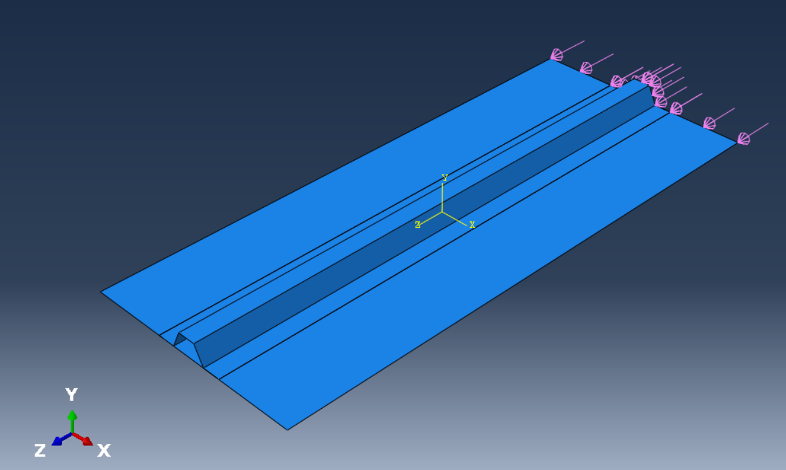
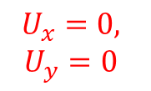
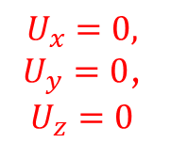


Mon-string Model
$$U_{x}=0,$$
$$U_{y}=0$$
$$U_{x}=0,$$
$$M_{z}=0$$
$$U_{x}=0,$$
$U_{y}=0$,
$$U_{z}=0$$
$$U_{x}=0,$$
$$M_{z}=0$$
Notes:
Post-buckling reliability design (vary lay-up)
Chapter 7: Robust Multilevel Design Optimization of Composite Panels
Robust and Reliability-Based Design Optimization of a Composite Floor Beam

Slide 5
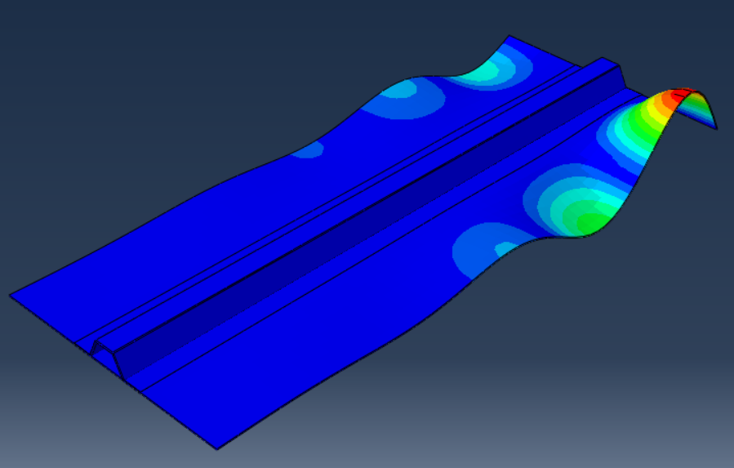
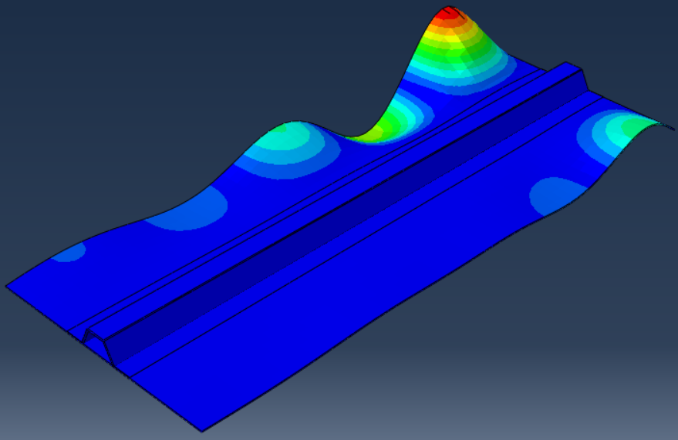
Eigenmodes

Slide 6
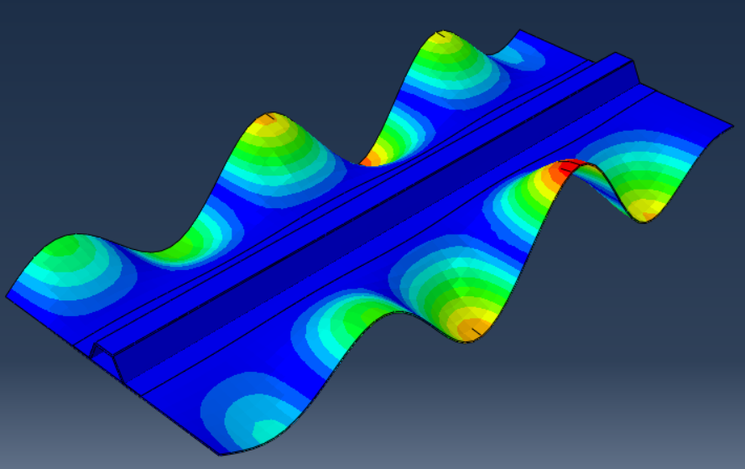
Eigenmodes
Eigenvalues O(10kN)

Slide 7
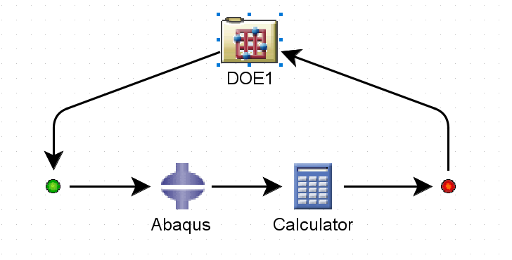
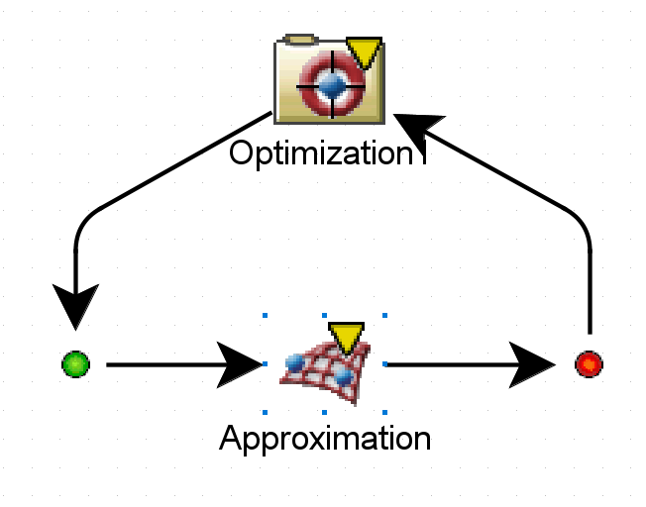
Challenges
Isight set-up fine (input/output importing with python scripts)
Runtime errors:
Error in dat file at line 211.
***ERROR: NODE SET ASSEMBLY_SIDESET HAS NOT BEEN DEFINED
Error in dat file at line 133.
***ERROR: THE MASTER SURFACE ASSEMBLY_PLATESURF DOES NOT EXIST.

Slide 8
Challenges

Slide 9
Next Steps
Interim presentation
Fix model
Model refinement - elements
Model refinement - composite layup at overlap
Opt algorithm tuning
Adding discrete lay-up design variables (combined or separately)
Reading up on studies for stiffened-plate buckling modes

Slide 10
Project plan
Workflow Test Case
Main Test Case
Design Studies
Computation
Final Report Work
Design Study Flow / Test Problem
Optimisation Methods
Results Analysis
Analytical Work + Research
Wks 17-19
Wks 1-3
Wks 4-9
Wks 9-15
Week | 1 | 2 | 3 | 4 | 5 | 6 | 7 | 8 | 9 | 10 | 11 | 12 | 13 | 14 | 15 | 16 | 17 | 18 | 19
Month | Jan |  | Feb |  |  |  | Mar |  |  |  |  | Apr |  |  |  | May

